Slide 1
Weld joint design
ISO 9692
Disclaimer
The European Commission support for the production of this publication does not constitute endorsement of the contents which reflects the views only of the authors, and the Commission cannot be held responsible for any use which may be made of the information contained therein​.​​​​​​

Slide 2
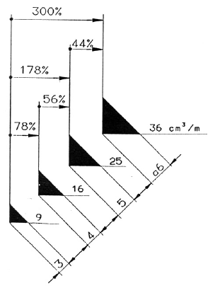
Welding cost, joint type and weld weight
Joint angle
Bevel angle
Top
Root face
Joint surface
Weld area = a²
Root
Root gap
Weld metal weight
V-Joint
HV-joint
Double V (X)
Double HV (K)
I-joint
Source: S Stenbacka Consulting
Reduce welding cost and welding time by reducing joint volume / weld weight.

Slide 3
Types of joint preparation for steels
SS-EN ISO 9692 part 1 & part 2
Welding and allied processes – Types of joint preparation for steels
Part 1: Manual metal arc welding, gas-shielded metal arc welding, gas welding, TIG welding and beam welding of steels.
Joint preparation for butt welds welded from one side
Joint preparation for butt welds welded from both sides
Joint preparation for fillet welds welded from one side
Joint preparation for fillet welds welded from both sides
Part 2: Submerged arc welding of steels.
Joint preparation for butt welds welded from one side
Joint preparation for butt welds welded from both sides

Slide 4
SS-EN ISO 9692-1
Example: Joint preparation for butt welds welded from one side

Slide 5
SS-EN ISO 9692-1
Example: Joint preparation for butt welds welded from both sides

Slide 6
SS-EN ISO 9692-1
Example: Joint preparation for fillet welds welded from one side

