Slide 1
Structural steels designation,
Grouping system for metallic materials and welding consumables standards
Disclaimer
The European Commission support for the production of this publication does not constitute endorsement of the contents which reflects the views only of the authors, and the Commission cannot be held responsible for any use which may be made of the information contained therein​.​​​​​​

Slide 2
Structural steel
Requirements on structural steel
Strength (also at high temperature)
Fatigue properties
Toughness
Homogeneity, also in the thickness direction (Z - properties)
Stiffness, Young modulus
Weldability
Corrosion properties
Hardness, wear and abrasion resistance
Dimension accuracy
Surface quality
General properties for steel:
Specific weight (density): ρ = 7800 kg/m³
Modulus of elasticity (Young): E = 2.1·10⁵ N/mm²
Share modulus: G = 0.8·10⁵ N/mm²
Poisson’s ratio: ν = 0.3
Coefficient of linear expansion: α = 1.2·10⁻⁵ 1/ºC.
Notes:
Desity

Slide 3
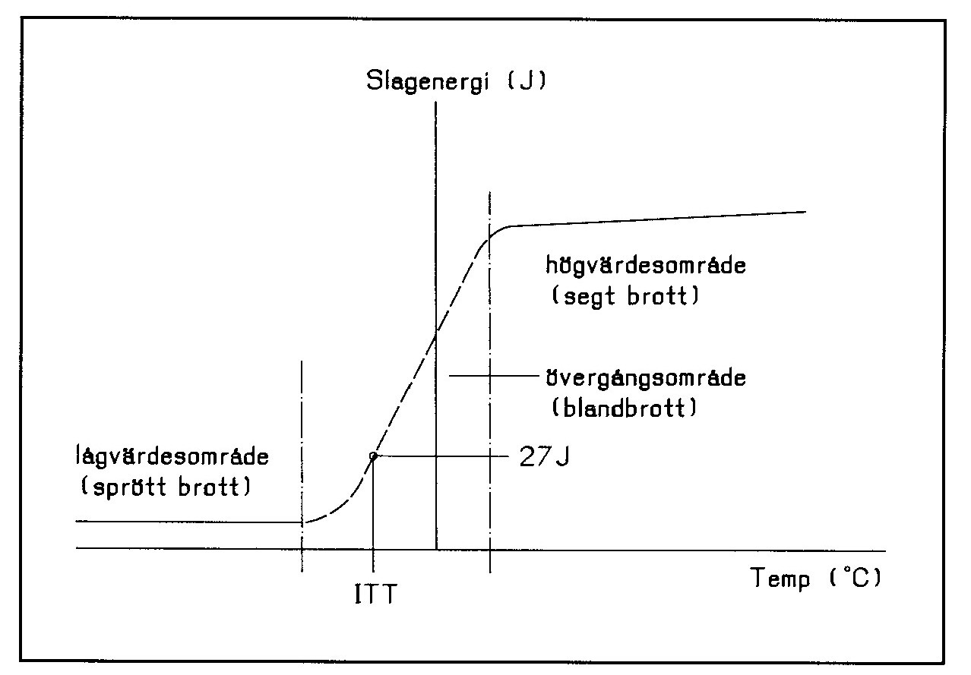
Toughness classes for steel acc. IIW
Due to the risk for brittle fracture steel can be of different quality classes from A to E with the highest requirements in class E.
A | B | C | D | E
Unkilled, semi killed or killed steel | semi killed or killed steel | semi killed or killed steel | semi killed or killed steel | Killed steel
Higher maximal impurity levels allowed than for higher toughness classes | Limited nitrogen content 0,0009%. Limited impurities. | Limited nitrogen content 0,0009%. Impact test at 0 º C | Limited nitrogen content 0,0009%. Impact test at -20 º C. Further Limitation of impurities. | Limited nitrogen content 0,0009%. Impact test at -40 º C
Fulfils moderate requirements and give some safety against cracks and pores in the weld metal A-steel today are in most cases better than this requirements. | For welded objects of moderate thickness and normal loads were the risk for brittle fracture do not needs to be taken into consideration. | For welded objects were due to thickness, loads and design a certain safety against brittle fracture are needed. | Intended for welded objects where safety against brittle fracture is required. due to low application temperature, thick material,, difficult load condition and complicated design. | For welded objects at low application temperature and difficult operating conditions
Killed steel: A deoxidizing agent has been added to the steel to prevent CO2 gas form during solidification. A killed steel has a more uniform chemical composition and properties than other steels. Silicon is commonly used as an agent. Without agent free oxygen inside the molten steel can react with the carbon and form bubbles of CO2 gas. Depending on the amount of addetives the steel can be killed, semi-killed or unkilled. Most steel today are killed!
Notes:
Killed steel: a deoxidizing agent has been added to the steel to prevent CO2 gas form during solidification. A killed steel has a more uniform chemical composition and properties than other steels. Silicon is commonly used as an agent. Without agent free oxygen inside the molten steel can react with the carbon and form bubbles of CO2 gas. Depending on the amount of addetives the steel can be killed, semi-killed or unkilled. Most steel today are killed!

Slide 4
Designation system for steel
Structural steel according to EC3
Two parallel systems:
Name system (alphanumerical), i.e. S355J2 according to SS-EN 10027-1.
Number system (numerical), ex 1.0577 according to SS-EN 10027-2
In Sweden the name system is used
Steel type Example
S Structural steel S355JR
P Pressure vessel steel P265NH
L Steel for tube/pipe L360NA
E Engineering (Machine steel) E295
G Cast steel GP240Gh
The number after steel type indicates the minimum value for
upper yield limit R_{eH} (N/mm²) for thicknesses up to 16 mm.
Impact requirements
(Fracture toughness)
Energy levels for impact
test Charpy-V notch at
27 J 40 J Temp (°C)
JR KR 20
J0 K0 0
J2 K2 -20
J3 K3 -30
J4 K4 -40
J5 K5 -50
J6 K6 -60

Slide 5
Designation system for steel
Additional requirements
A Annealed
AcC Accelerated Cooling
AR As Rolled
C Cold formed steel
CR Controlled Rolling
E Tempered
G1 Unkilled
G2 Killed / semi killed
G3 Plate: Normalized or controlled rolled
Profiles: Any state of delivery if not agreed upon.
G4 Any state of delivery if not agreed upon
H Thermomechanical treated
Ln: Low temperature
M: Thermomechanical rolled
N Normalized
O Offshore application
Q Quenched
S Ship application
T Tempered (QT)
TM Thermomechanical rolled steel
W Weather durability
Notice that
TM- and AcC- steel can not be warmed at temperatures above 500 to 600°C type hot straightening
Quenched and tempered steel can not be heated above tempering temperature about 450 to 650 °C
Normalized steel can heated to around 950 °C and can be hot bent and straightened

Slide 6
General structural steels
Standards for structural steel
Hot rolled products of non-alloyed structural steels (Carbon-manganese steel)
Suitable for welding. Used in buildings, machines, vehicles.
Example: SS-EN 10025-2-S275J2, S355J2 (1.0577)
Hot rolled products of weldable fine grain steels (Normalized fine grain steel)
Good weldability and high strength. Used frequently in buildings. Can be normalized after delivery without losing strength.
Example: SS-EN 10025-3-S355NL (L: 27J/-50 °C, without L: 40J/-20 °C)
Hot rolled products of weldable fine grain steels (thermometrical rolled steel)
Lower carbon equivalent than the normalized steel. Gives better weldability. Loses its strength above temperatures more than 580 ºC.
Example: SS-EN 10025-4-S355ML
Structural steel with improved atmospheric corrosion resistance
Example: SS-EN 10025-5-S355J2W
High yield strength structural steels in the quenched and tempered condition
To be used when higher demand for strength than micro alloyed steels can meet.
Example: SS-EN 10025-6-S690QL (L: 30J/-40 °C, L1: 30J/-60 °C, without L: 30J/-20 °C)

Slide 7
General structural steels
Standards for structural steel
Thermomechanical rolled steel for cold forming
The steels are used in transport industry due to their bendability. Will loose strength if the temperature is higher than 580 ºC. Lower carbon equivalent than the normalized steels 10149-3.
Example: EN 10149-2-S420MC (M: Thermomechanical rolled. C: steel for cold forming)
Normalized steel for cold forming
The same bendability, lower yield strength and higher carbon equivalent (less weldability) than the Thermomechanical rolled steels but can be normalized without affecting the strength
Example: SS-EN 10149-3-S420NC
Hot finished structural hollow sections of non-alloy and fine grain steels
Example: SS-EN 10210-1-S355J2H
Cold formed welded structural hollow sections of non-alloy and fine grain steels
Example: SS-EN 10219-2-S355J2H
Alloyed steels, like stainless steels.
Example: SS-EN 10088 1.4301 (X5CrNi18-10) / 1.4462 (X2CrNiMoN22-5-3) Duplex 2205

Slide 8
SIS-CEN ISO/TR 15608 Metallic materials grouping system
Welding – Guidelines for a metallic materials grouping system
Group | Type of material
1.1 1.2 1.3 1.4 | CMn-steel with a yield strength , R_{eH} ≤ 275 N/mm² Steel with a yield strength 275 < R_{eH} ≤ 360 Normalized steels yield strength R_{eH} > 360 N/mm² Steels with improved atmospheric corrosion resistance
2 | Thermomechanically treated fine-grain steels and cast steels, R_{eH} > 360 N/mm²
3 | Quenched and tempered and precipitation-hardened fine-grain steels, R_{eH} > 360 N/mm²
4 5 6 | Low vanadium alloyed Cr-Mo-(Ni) Cr-Mo steels free of vanadium with C ≤0.35% High vanadium alloyed Cr-Mo-(Ni) steels
7 | Ferritic, martensitic or precipitation-hardened stainless steels 10,5%<Cr<30%
8 | Austenitic stainless steels, Ni ≤ 31%
9.1 9.2 9.3 | Nickel alloyed steels Ni ≤ 3% Nickel alloyed steels 3% < Ni ≤ 8% Nickel alloyed steels 8% < Ni ≤ 10%
10 | Austenitic ferritic stainless steels (duplex
11 | Steels covered by group 1 except 0,25% < C ≤ 0,85%
21-26 | Aluminium och aluminium alloys
31-38 | Copper och copper alloys
41-48 51-54 61-62 71-76 | Nickel and nickel alloys Titanium och titanium alloys Zirconium och zirconium alloys Cast iron

Slide 9
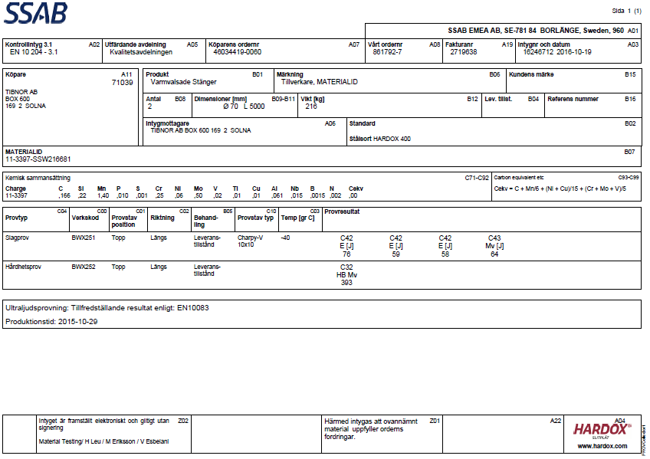
SS-EN 10204-3.1 Inspection Certificate for steel
Inspection certificate EN 10204-3.1: The supplier certifies that the goods comply with the order and states test results, the document is validated by an independent authorized inspector.

Slide 10
EN-Standards for consumables
Method | 111 MMA | 131, 135 MIG/MAG | 141 TIG | 121, 122 SAW |  | 114, 136, 138 MAG | 131 Gas welding
Consumable | covered electrode | Solid wire | Solid wire/rod | Wire/band | Flux | Tube electrode | Solid wire
Non alloyed & fine grain steels | 2560 | 14341 | 636 | 14171 | 14174 | 17632 | 12537
High strength steels | 18275 | 16834 | 16834 | 26304 | 14174 | 18276 | -
Creep-resisting steels | 3580 | 21952 | 21952 | 24595 | 14174 | 17634 | (ISO missing)
Stainless & Heat resistant steel | 3581 | 14343 | 14343 | 14343 | 14174 | 17633 | -
Nickel & nickel- alloys | 14172 | 18274 | 18274 | 18274 | 14174 | 12153 | -
Cupper & cupper alloys | - | 24373 | 24373 | - | - | - | -
Aluminium | - | 18273 | 18273 | - | - | - | -
Cast grey iron | 1071 | 1071 | 1071 | - | -
Titanium | - | 24034 | 24034 | - | - | - | -

Slide 11
Covered and cored electrodes – Example
Covered electrodes, MMA
Flux cored tubular wire electrodes, MIG/MAG
Method 111: OK 55.00
E 46 5 B 12 H5
Method 136: OK Tubrod 15.15:
T 46 2 P C 1 H5 / T 46 2 P M 2 H5

Slide 12
Consumables for non alloyed & fine grain steels
SS-EN ISO2560: E 46 5 B 12 H5
SS-EN ISO 17632: T 46 2 P C 1 H5
SS-EN ISO 17632: T 46 2 P M 2 H5

