Slide 1
External anatomy of the Salmon
Learn about the external features and their function.
Click on the salmon to begin.
Text and logo for Open Licence
All images Copyright: Kare Romuld, Guri Kunna videragaende skole, Froya, Norway
Close the activity

Slide 2
External anatomy of the Salmon
Hover your mouse over each feature to show its name.
(11 features are named. The red arrows indicate two of them.)
Click on each feature to find out more detail.
(Click again to return to this page.)
Close the activity

Slide 3
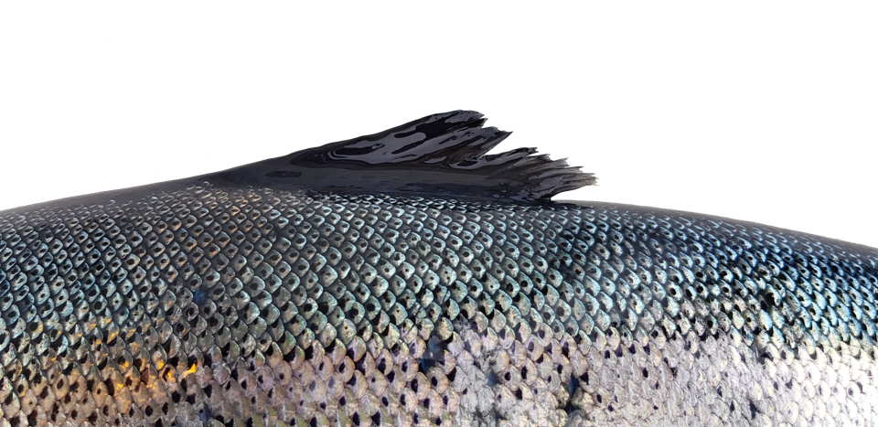
The Dorsal Fin is on the top of the body.
This fin helps to provide stability for the fish in the water so that it can maintain an upright position when swimming.
(Click anywhere to return to the whole fish)

Slide 4
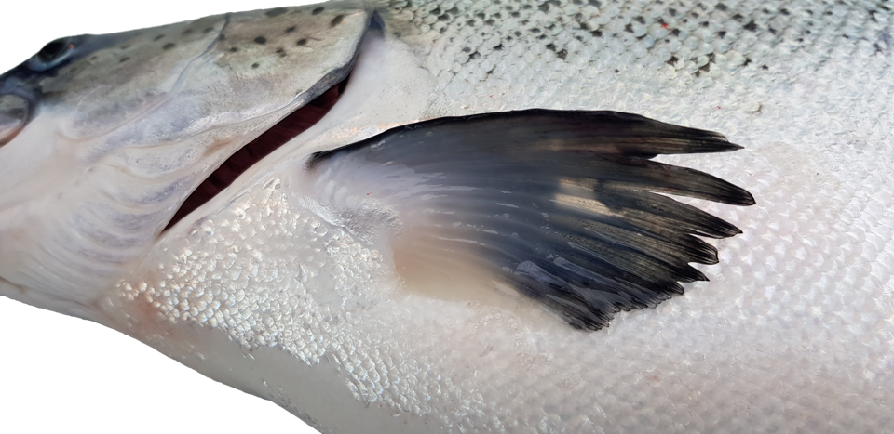
The Pectoral Fins are at the front of the body, on either side, just behind the head and operculum.
They are used for steering, braking and moving up and down.
(Click anywhere to return to the whole fish)

Slide 5
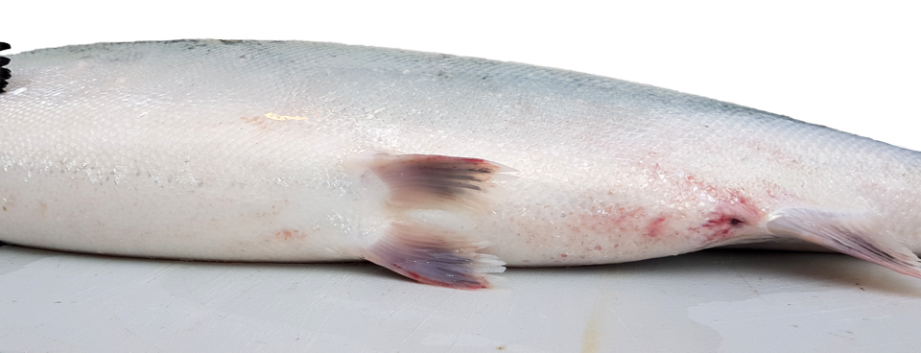
Pelvic Fins
These fins helps with up/down movement,
braking and turning.
(Click anywhere to return to the whole fish)

Slide 6
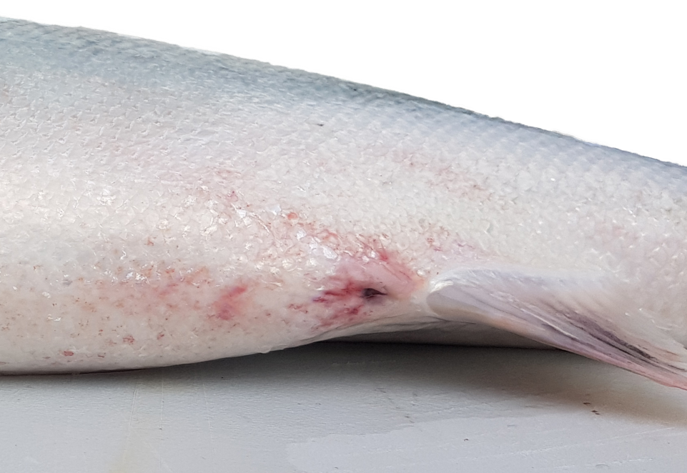
Anal Fin
Anal vent
The Anal Fin, is similar in function to the Dorsal Fin.
It helps to stabilise the fish when it is swimming.
(Click anywhere to return to the whole fish)

Slide 7
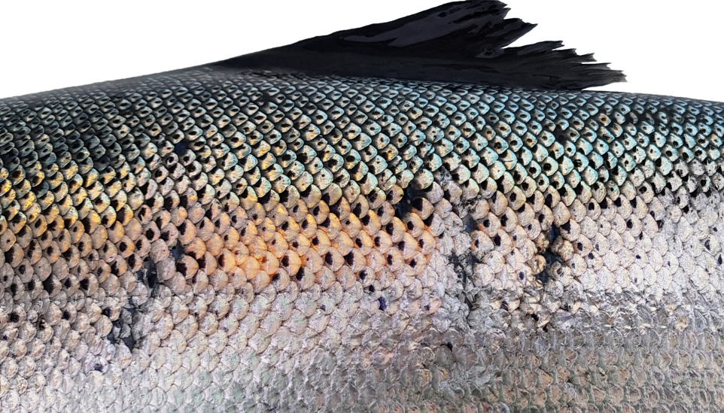
Lateral Line
The Lateral Line functions like a mammalian ear.
It is formed from a series of liquid-filled canals below the skin which run along the side of the fish. These are very sensitive to vibrations and pressure waves in the water. Fish use the lateral line to detect disturbances. This helps them to avoid predators, and in the case of the carnivorous salmon, track their prey.
(Click anywhere to return to the whole fish)

Slide 8
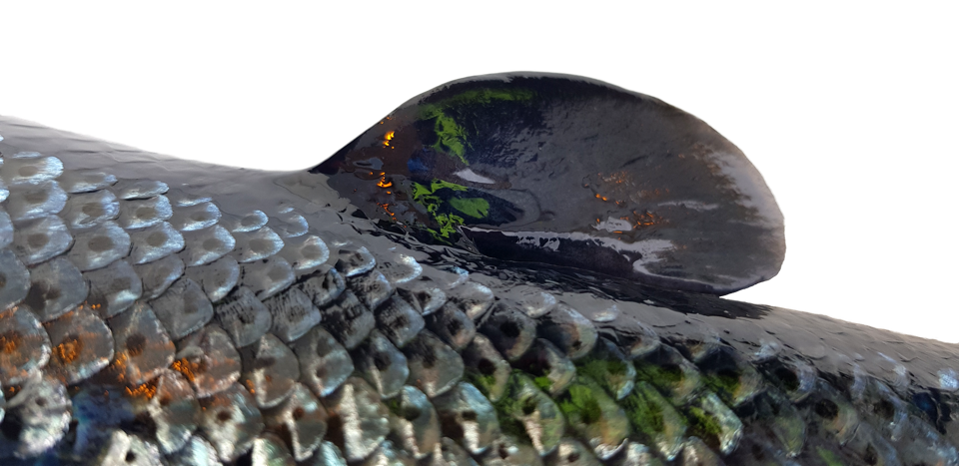
Adipose Fin
Purpose unknown! It is basically a fatty tissue.
(Click anywhere to return to the whole fish)

Slide 9
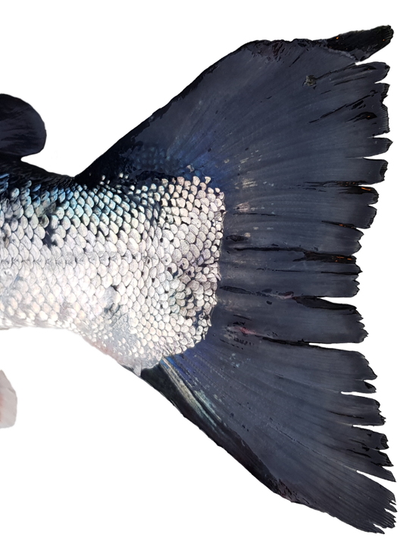
Caudal Fin (tail fin)
This fin has a large surface area to help propel the fish through the water.
(Click anywhere to return to the whole fish)

Slide 10
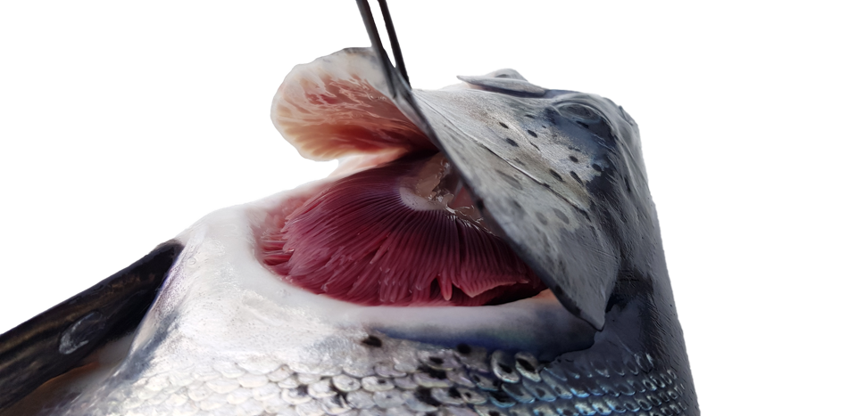
The Operculum has been lifted to show the gills below.
The Operculum protects the gills. It is a firm but slightly flexible outer casing that operates like a hinged plate.
The fish can open and close it to draw in and regulate the flow of water over the gills.
The Operculum beat rate can be controlled according to the dissolved oxygen content of the water and the oxygen requirement of the fish.
(Click anywhere to return to the whole fish)

Slide 11
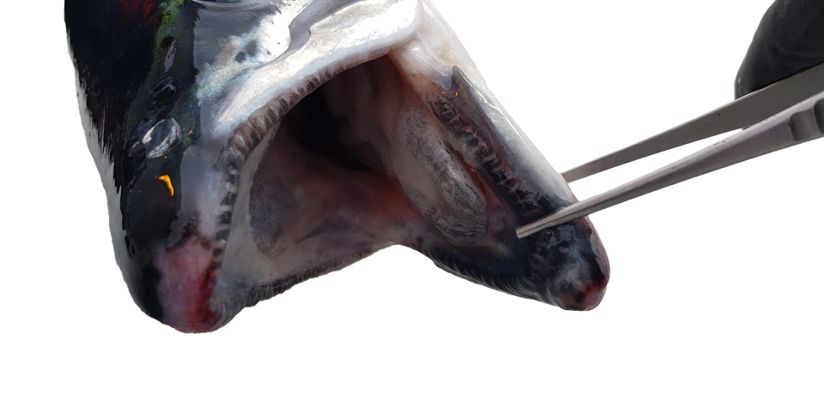
The Mouth
Salmon have the mouth parts of a typical carnivore.
The wide gape and sharp, very small, needle-like teeth have evolved for grabbing and holding on to their prey.
Prey are then swallowed whole.
Salmon have a tongue bearing teeth and mouth
parts which may be taste sensitive, although this has not been well researched.
(Click anywhere to return to the whole fish)

Slide 12
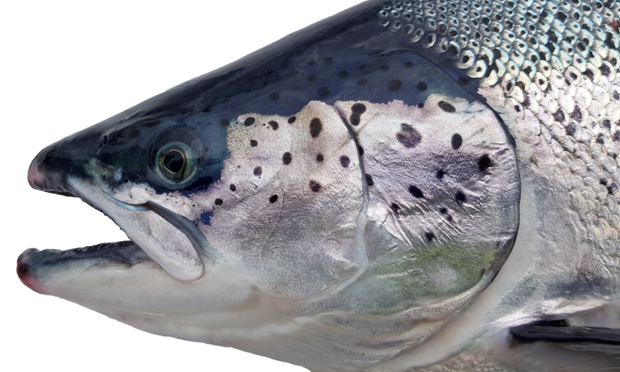
The Eyes
The eye of a salmon has the same basic structure as other vertebrates: cornea, iris, pupil, lens, and retina.
However, the iris is fixed and cannot regulate the light entering the eye.
Instead, the retina adjusts the position of photoreceptors.
Consequently, the eyes of a salmon and most fish take longer than many vertebrates to adjust to changing light levels.
(Click anywhere to return to the whole fish)

Slide 13
Nares (nostrils)
Fish have nostrils that are a small indention unconnected to the mouth.
Unlike mammals, fish nostrils are not used for respiration. They can smell very low concentrations of chemicals in the water, allowing them to detect harmful pollution and avoid potential threats. Salmon also use smells to recognise their way home from the ocean to the spawning grounds that they originate from.
(Click anywhere to return to the whole fish)

