Slide 1
Internal anatomy of the Salmon
Learn about the internal organs and their function.
Click on the salmon to begin.
Text and logo for Open Licence
Close the activity
All images Copyright: Kare Romuld, Guri Kunna videragaende skole, Froya, Norway

Slide 2
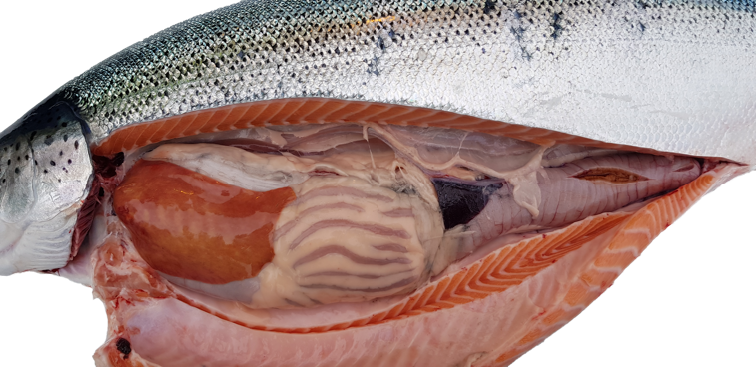
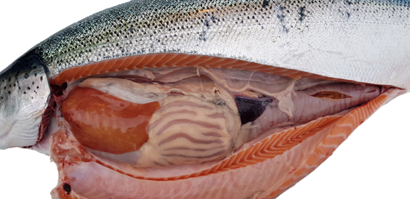
Internal anatomy of the Salmon
Hover your mouse over each organ to show its name.
(10 organs are named. Yellow arrows/boxes indicate organs revealed with further dissection.)
Click on each organ to find out more detail.
(Click again to return to this page.)
Under spinal column
Beneath these organs
Beneath these organs
Under Operculum
Beneath Gills
Close the activity

Slide 3
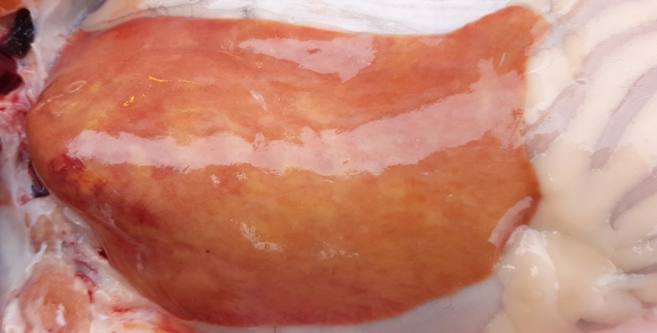
The Liver is the largest organ in the fish’s body and is part of the digestive system.
It is essential for maintaining chemical and sugar levels in the blood (just as it does in mammals).
It stores, synthesises and secretes essential nutrients.
Bile is produced by the liver then stored in the gall bladder and released for the break-down of fats.
Finally, the liver is a cleansing organ. It removes metabolic wastes from the blood and aids the recycling of old blood cells.
(Click anywhere to return to the whole fish)

Slide 4
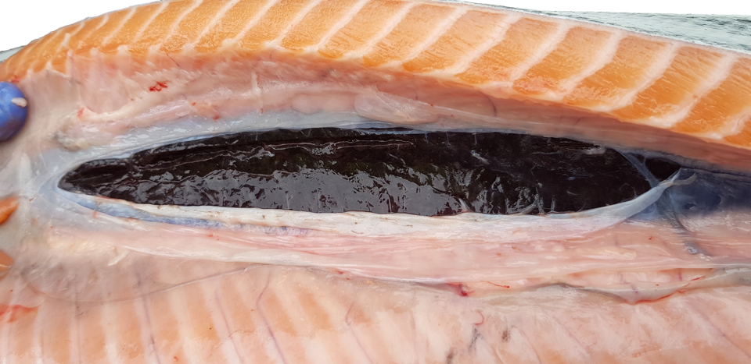
Hover over the kidney for cross section
Salmon have two Kidneys joined together. They are positioned under the spinal column. The front kidney produces red blood cells and the back kidney cleans the blood. Urine is collected by ducts near the vent.
The kidneys have a critical osmoregulation role to play within smoltification. They allow the young salmon to safely transfer from fresh to salt water.
(Click anywhere to return to the whole fish)

Slide 5
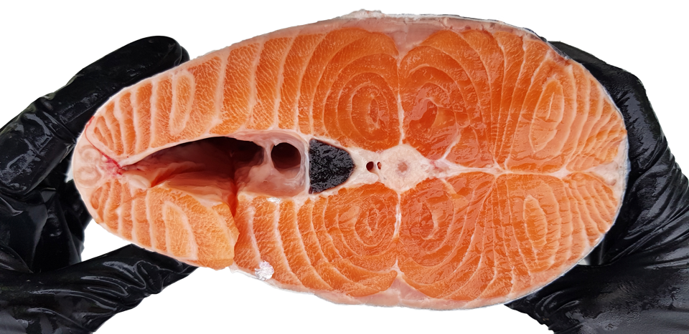
Kidney
Spinal column
Salmon have two Kidneys joined together. They are positioned under the spinal column. The front kidney produces red blood cells and the back kidney cleans the blood. Urine is collected by ducts near the vent.
The kidneys have a critical osmoregulation role to play within smoltification. They allow the young salmon to safely transfer from fresh to salt water.
(Click anywhere to return to the first kidney image)

Slide 6
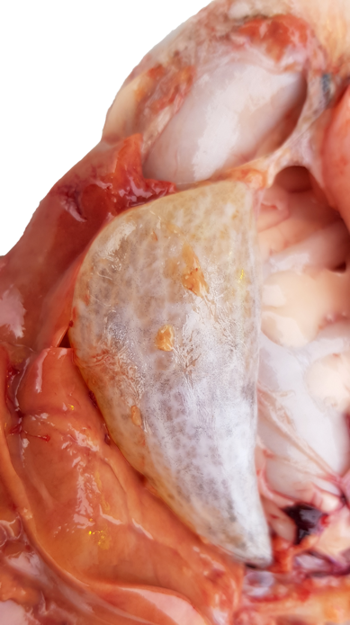
Salmon fill their Swim Bladder with air for the first time as swim-up fry.
The air provides buoyancy, allowing them to hold their position in the water column without using so much energy.
They can adjust the gasses in their swim bladder to allow them to alter their holding depth.
(Click anywhere to return to the whole fish)

Slide 7
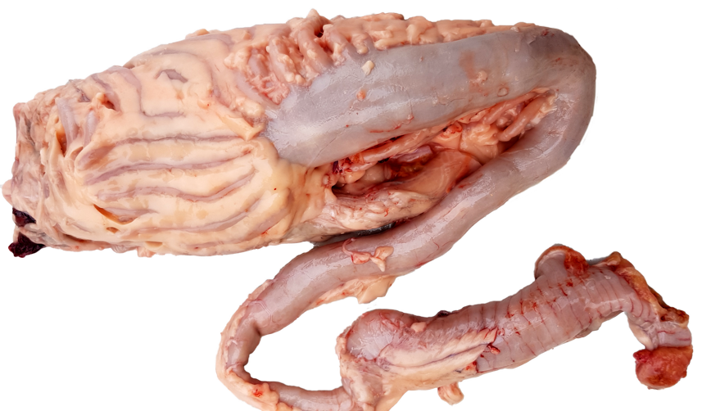
Pyloric Caeca
Anal Vent
The Intestine extends from the pyloric caeca to the anal vent and is relatively short compared to mammals and herbivorous fish.
As a carnivore, the natural diet of salmonids is high in protein and low in carbohydrates. Therefore most of the digestion occurs in the stomach.
(Click anywhere to return to the whole fish)

Slide 8
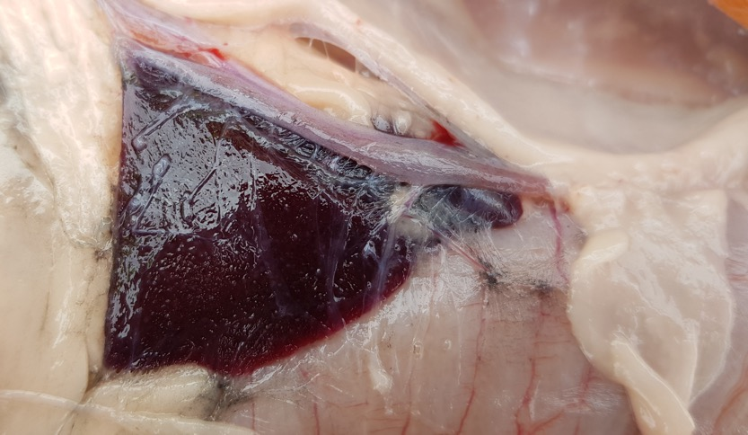
The Spleen is a storehouse for blood.
It helps to control the amount of blood circulating through the body by creating a reserve pool that can be released during severe bleeding. This helps to improve circulation and oxygenation. The spleen also recycles worn-out red blood cells.
(Click anywhere to return to the whole fish)

Slide 9
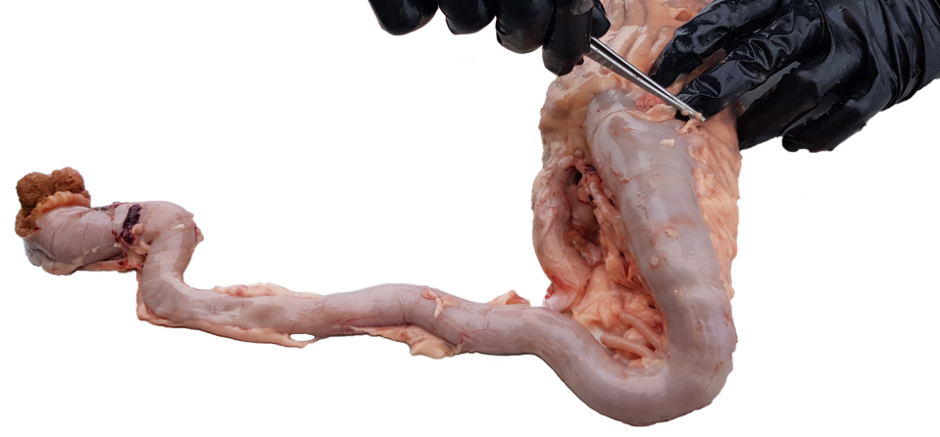
The Stomach is a ‘U shaped’ sac-like digestive organ receiving food from the oesophagus.
It contains enzyme secreting glands within a folded internal wall.
The stomach is relatively muscular in salmonids. It can compress the high protein food to aid digestion. The muscles can also relax, to allow more food to be brought in during periods of intensive feeding.
The stomach’s pH is 5. This pH is required by the protein digesting enzymes (proteases) such as pepsin that start the protein break down process.
(Click anywhere to return to the whole fish)

Slide 10
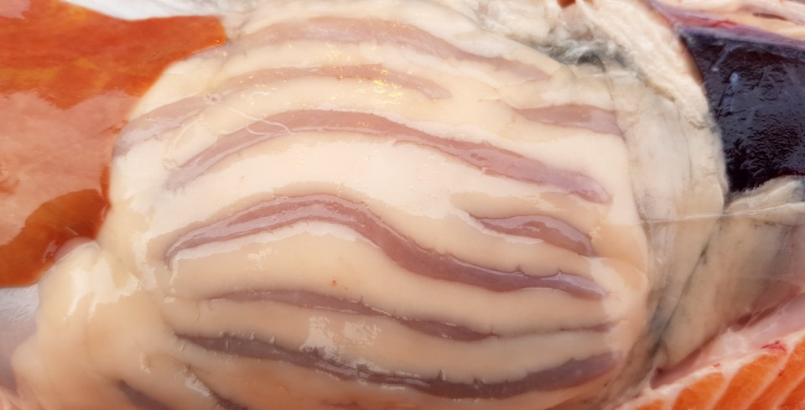
The Pyloric Caeca’s function is not well understood. It is thought to secrete digestive enzymes and have a nutrient absorption role.
Since it takes the products of digestion into the blood stream for internal-transportation round the body, it can be likened to the small intestine in mammals.
(Click anywhere to return to the whole fish)

Slide 11
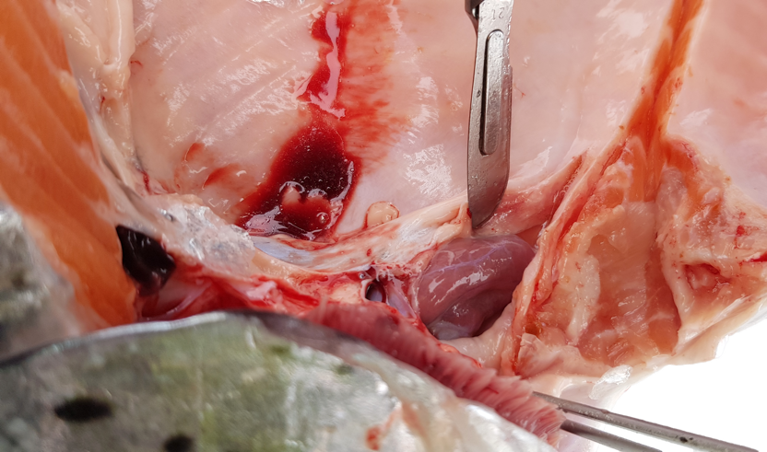
Operculum
Gills
The Heart is connected to the gills by the ventral aorta and drives the blood round the body via a ‘single circulatory system’.
Once the blood has been pumped to the gills to absorb oxygen it then passes round the rest of the body.
This is not like mammals, where the blood returns to the heart before being pumped round the body within a ‘double circulatory system’.
(Hover over the heart for closer image)
(Click anywhere to return to the whole fish)

Slide 12
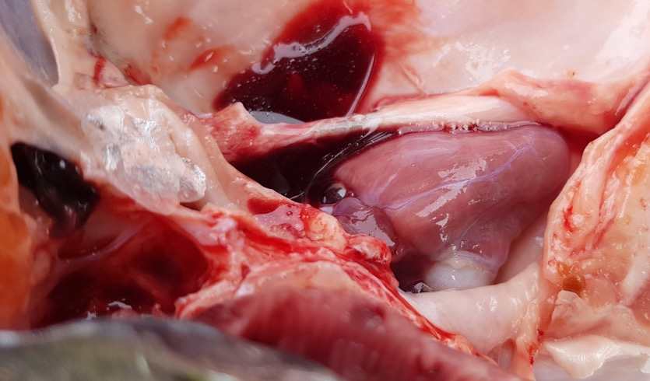
The Heart is connected to the gills by the ventral aorta and drives the blood round the body via a ‘single circulatory system’.
Once the blood has been pumped to the gills to absorb oxygen it then passes round the rest of the body.
This is not like mammals, where the blood returns to the heart before being pumped round the body within a ‘double circulatory system’.
(Click anywhere to return to the first heart image)

Slide 13
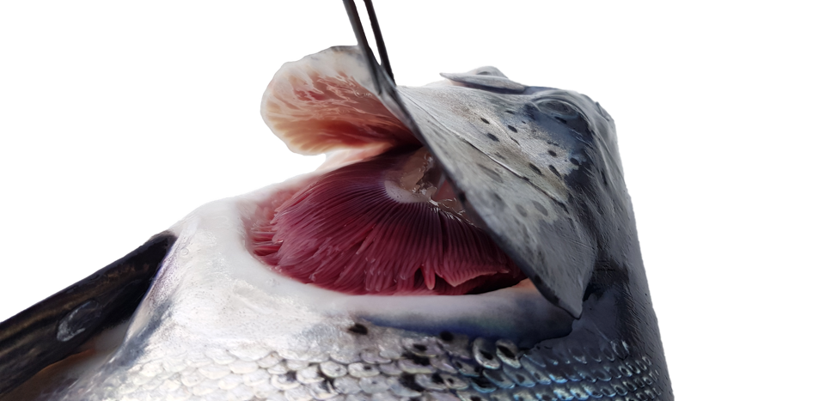
Healthy Gills are red because they are filled with oxygen rich blood.
They take oxygen from the water by diffusion and expel carbon dioxide into the water.
The gills contain lamellae which are fine, branched structures only two cells thick, to provide the greatest possible surface area. They perform the same function as alveoli in the mammalian lung but do so more efficiently.
(Click anywhere to return to the whole fish)

Slide 14
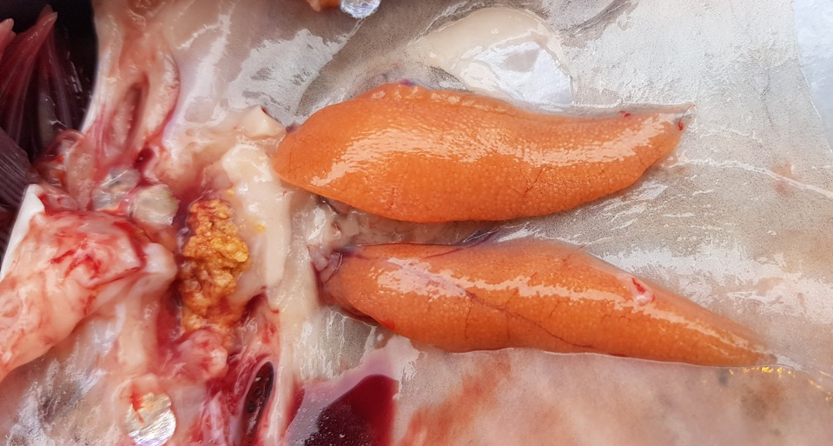
Gills
Ovaries
The female reproductive organ which produces eggs.
(Click anywhere to return to the whole fish)

